Slide 1
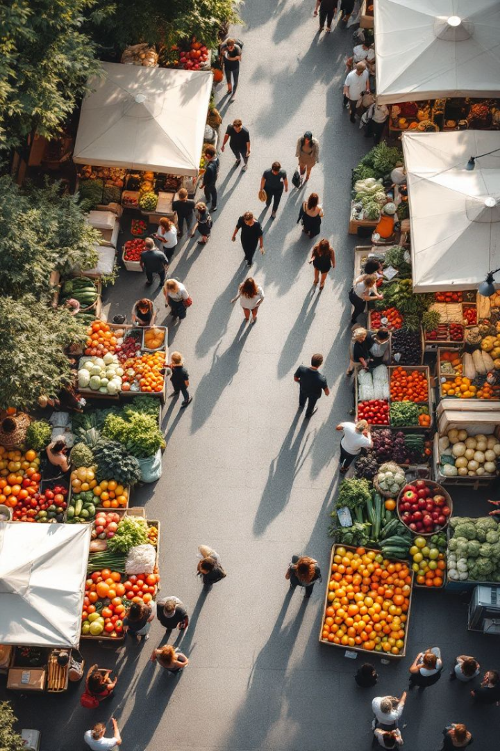
Food Redistribution Interface
Food waste is a critical global issue, with millions of tons of edible food being discarded each year, while many people still go hungry. This project introduces a technologically advanced platform to bridge the gap between food donors (restaurants, supermarkets, individuals) and recipients (NGOs, shelters, food banks).

Slide 2
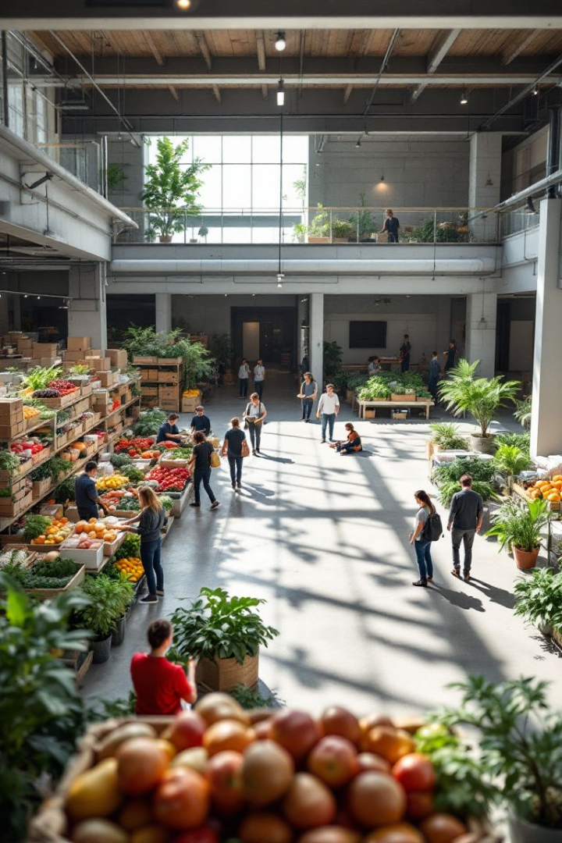



Existing Food Redistribution Systems:
Existing systems face limitations. While several initiatives address food insecurity, they often operate in silos, lack coordination, or face scalability issues. Food banks and soup kitchens are valuable, but they usually depend on unpredictable donations and volunteer work. Moreover, these systems may not offer real-time updates, leading to delays, redundancies, or spoilage
Food banks
Soup kitchens
Provide meals
Dependent on volunteers
Imperfect Foods
Focus on produce

Slide 3
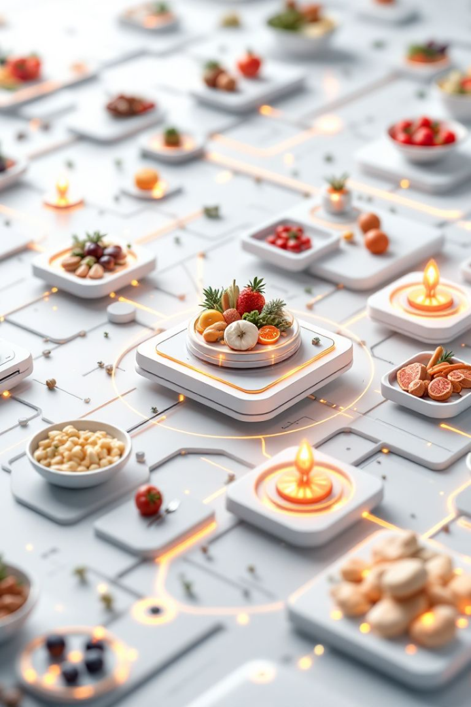


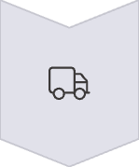
A Food Redistribution Interface
Our platform connects businesses with surplus food to organizations in need. Restaurants and farms list available food in real-time. A matching algorithm connects donors with recipients. Integrated delivery services ensure efficient transportation.
Real-time inventory
Matching algorithm
Transportation

Slide 4
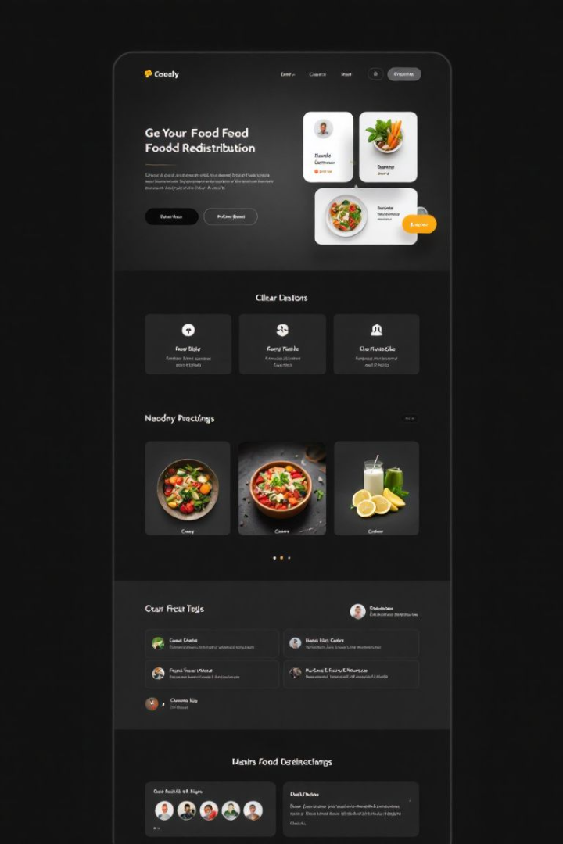
Key Requirements for the Interface
Our interface prioritizes user-friendliness for both donors and recipients. Secure data management ensures food safety and traceability. Location-based search and mobile access are essential. Integration with existing databases is crucial.
User-friendly
Secure data
Easy for all users
Ensure food safety
Location based
Find nearby options

Slide 5




Implementation: System Architecture
Our system architecture leverages cloud infrastructure. Donors, the interface, and recipients share data. A relational database stores food listings and user profiles. APIs and mobile frameworks ensure accessibility.
Cloud
1
Database
Infrastructure
2
Storage
Interface
4
APIs
3
Access
Connections

Slide 6
Visualizing the Output
Donor dashboards offer food listing options. Recipient dashboards display available food and delivery scheduling. Mobile apps provide navigation and delivery confirmation. These visuals enhance usability and efficiency.
Donor dashboard
Recipient dashboard
Listing options
Delivery scheduling

Slide 7
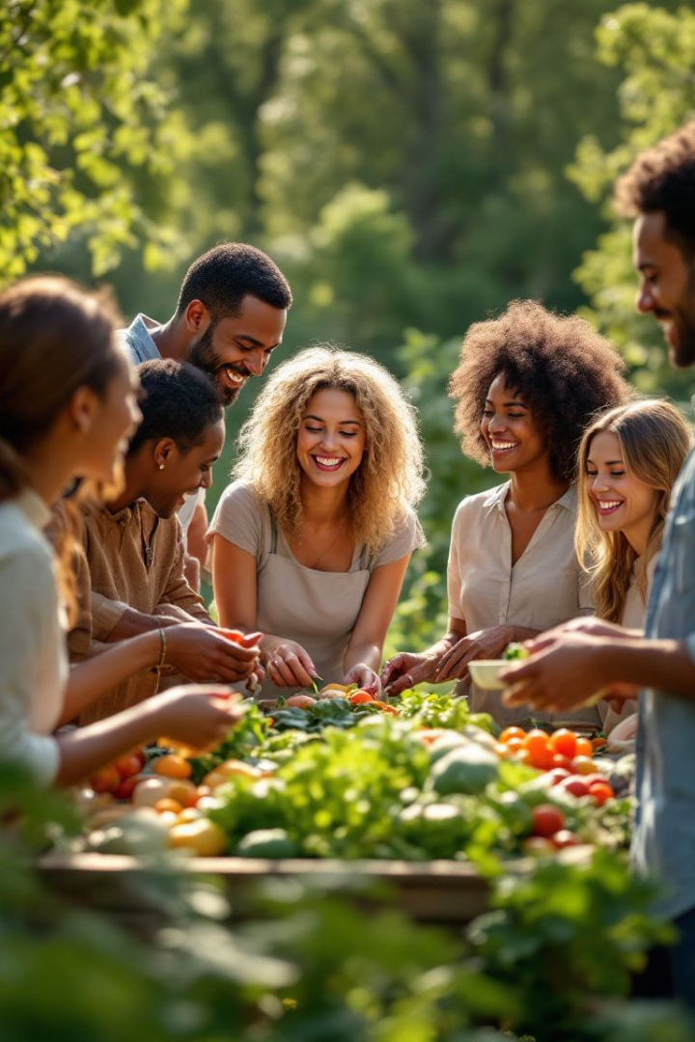



Advantages of the Food Redistribution Interface
Our interface reduces food waste and increases food access. Businesses save on disposal fees. Environmental benefits include lower emissions. We aim for community impact and collaboration.
Reduce Waste
Increase Access
Cost Savings

Slide 8



Conclusion: A Solution
Our interface offers a scalable solution. We can combat food waste and hunger by connecting surplus food with those in need. Participate in our platform and support food redistribution efforts. Together, we can create a sustainable food system.
1
Sustainable Food
2
Reduce Hunger
3
Combat Waste

